Slide 1
HONG KONG INTERNATIONAL FOOD WEEK

Slide 2
International FOOD Company
Selling international food products in China and Hong Kong
Fast growing company
Import: Europe (France, Italy, Hungary), Asia (Vietnam, Japan), South America (Mexico)
Spices, handmade pasta, traditional food

Slide 3
International FOOD WEEK
PROMOTING OUR PRODUCTS!
1 Week=7 days in Hong Kong
Close to international restaurants (main target)
Visitors could buy our products

Slide 4
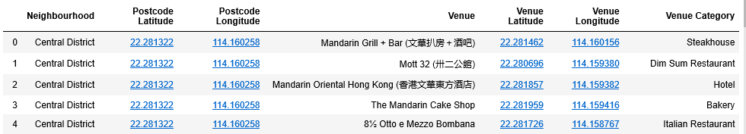
Data-Hong Kong neighborhoods and venues
Foursquare, Wikipedia

Slide 5
Methodology
Division-7 category:
North America
South America
Asia, but not China
Australia
Europe
China
Others( for example Vegan)
Filter: „restaurant”
Count of numbers in each category
K-means clustering: 3 clusters
CHOOSING THE MOST DIVERSIFIED CLUSTER!

Slide 6
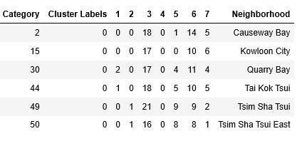
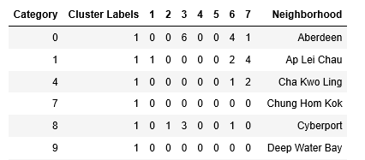
Results
Cluster 1:
The most diversified neighborhoods
Cluster 2:
Restaurants are very rare

Slide 7
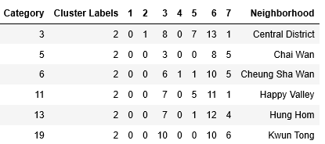
Results
Cluster 3:
Only Chinese Restaurants

Slide 8
Conclusion & Discussion
1. Cluster is the most diversified!
BUT! People from Hong Kong tend to like more other Asian food for example Vietnamese or Japanese.
Main focus: Asia! Europe, other part of the world-smaller role
We need to examine further with quantitave and qualititave methods where exactly this event could take place. For that we need to count possible revenues and costs.

